Slide 1
HEALTH IN HANDS
OUR TEAM:
Siddhant Singhal
Kamala Nayana Uppalapati
Reshma Konepalli
Ramya Nimmagadda
Mohit Ramani

Slide 2
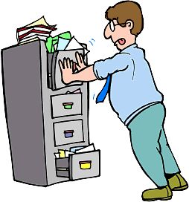
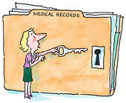
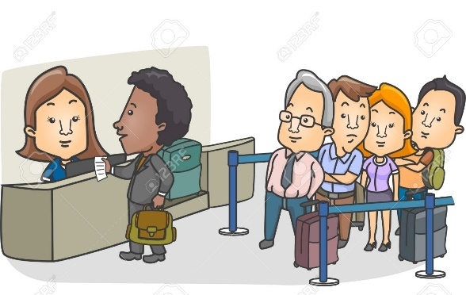
Problem
Missing medical records
Small clinics/hospitals do not maintain patient’s records
Wait time in the hospitals/clinics for consultation
Difficulty in finding the best suited doctor
We go through some of the tests that we do not need only because of missing reports

Slide 3

Solution
An application/service that will help us to record our medical reports
An application that will help in searching the best suited doctor for our problem
An application that will give us information on the nearest diagnostic centers
An application that will help us in scheduling an appointment with ease

Slide 4
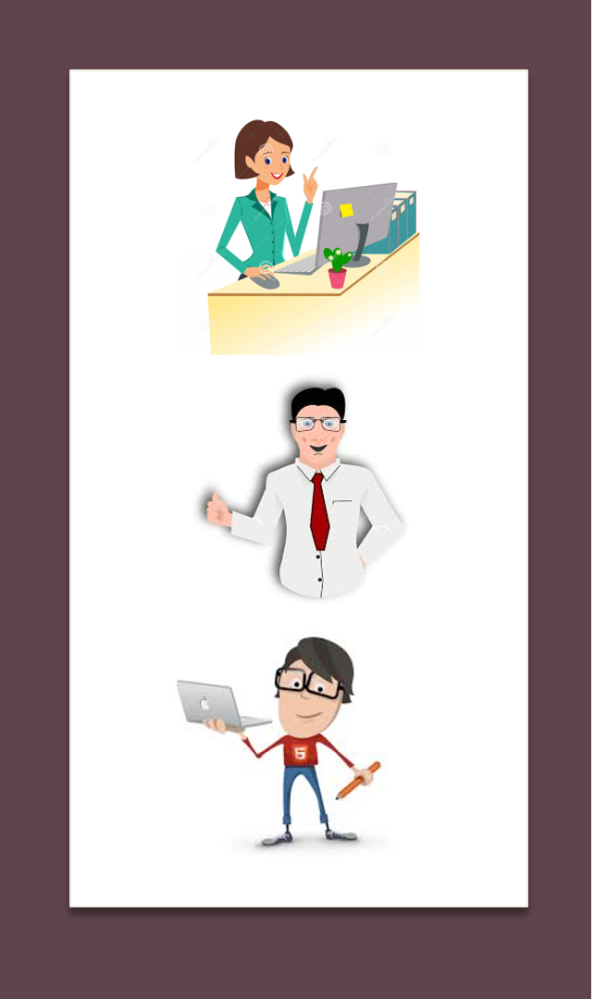
Stakeholders
Diagnostic Centers
Doctors
Patients

Slide 5

Who are the users?
Who are the sponsors?
Indian Medical Association is the only representative voluntary organization of doctors of modern scientific system of medicine which looks after the interest of doctors as well as the well being of the community at large
People who what to maintain their health records electronically
Doctors and Health organizations who want to reach out patients online

Slide 6
Problem-1
Record keeping of medical history
Solution: The records are available on the application which can be accessed with there “Health in Hands” account (connecting application to a database on cloud).
Also, hard copy of any medical record can be retrieved by the user with access level.
Easy access to Diagnostic center for uploading the reports for the patients.

Slide 7
Problem-2
Time wastage in waiting area to see doctor, failure in appointment scheduling and real-time tracking of appointment status.
Solution: Application functionality for
Doctor: can manage the appointment calendar.
Patient: can book an appointment and review the status of appointment in real time.

Slide 8
Problem-3
Solution Summary
Patient:
Might reduce the count of Medical tests to go through with.
Record keeping.
Appointment Scheduling.
Doctor:
Easy access to records, which expedite the prescribing process.
Diagnostic Center:
Less tests to be performed for the same patient based on previous medical reports

Slide 9
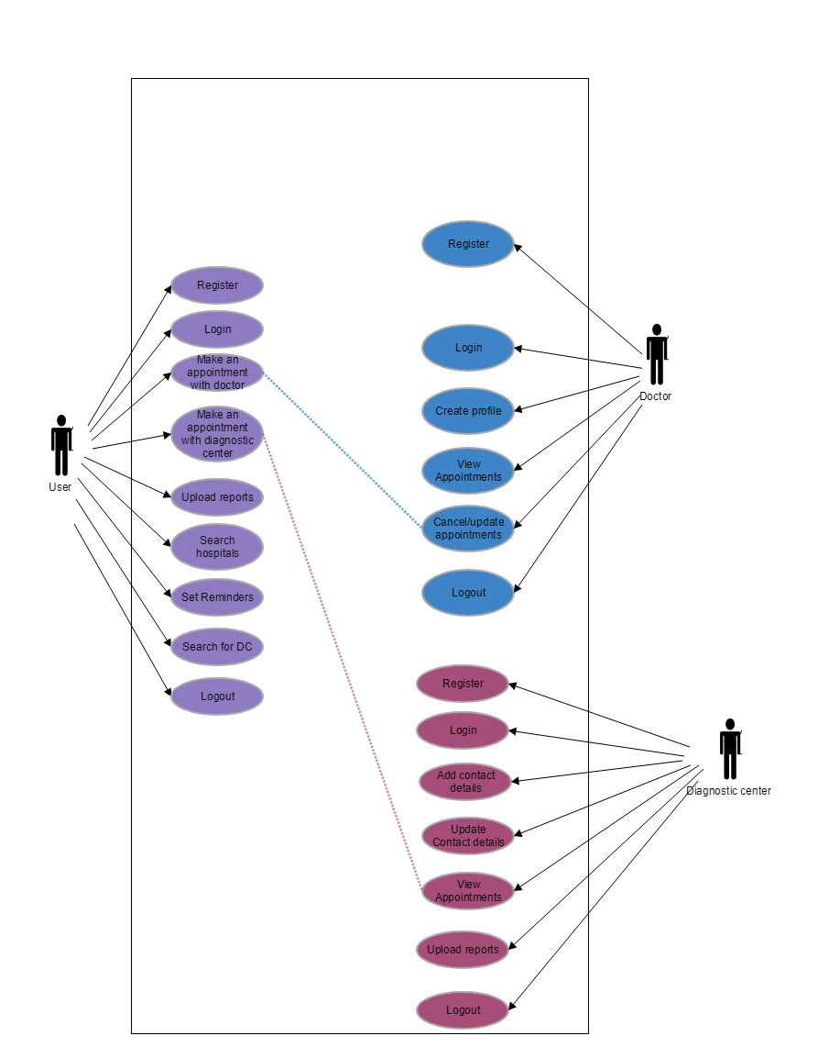
Use-case Diagram

Slide 10
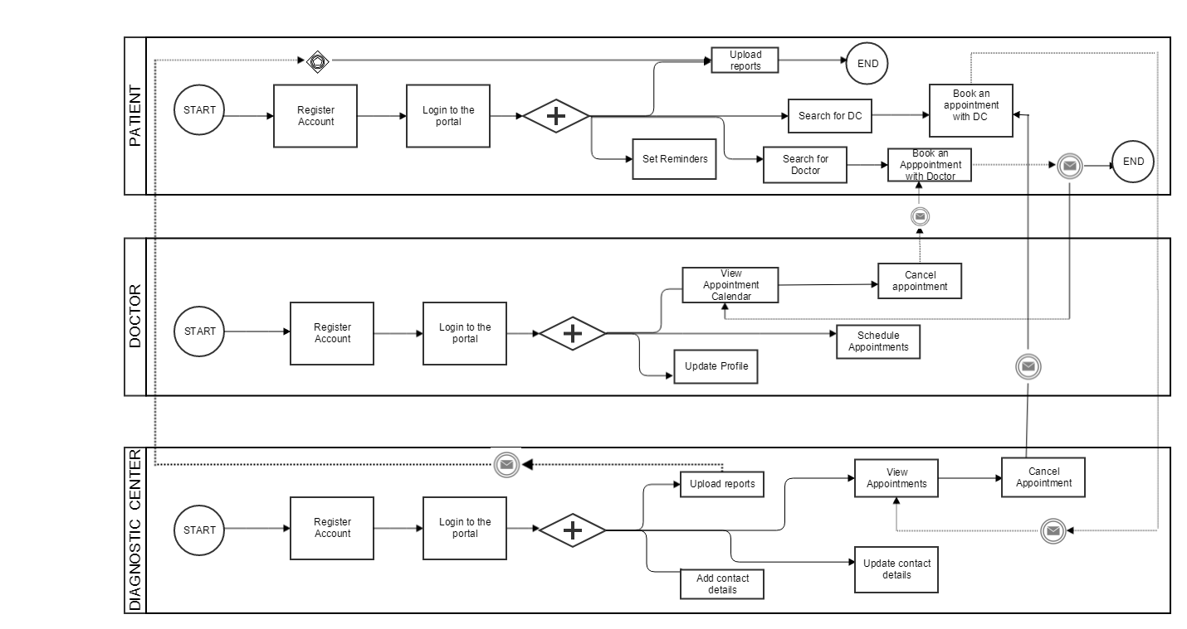
Business Process Flow Diagram

Slide 11
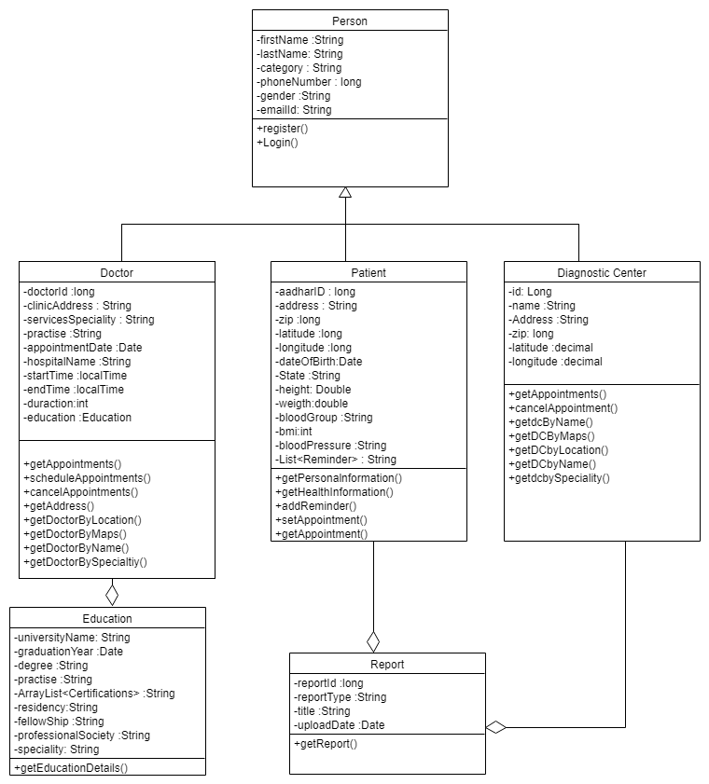
Class Diagram

Slide 12
Future Scope
Health in Hands application can be extended to other countries
This application can also be extended to android users
Patient would be able to view what medicines are available in a particular pharmacy and order them online
Patient would be able to share reports with doctor if required
Patient would be able to setup a video call with doctor

Slide 13
Technology Stack Used
Mobile Application (IOS)
Programming languages – Objective C, Swift
Web Technologies- HTML, CSS, javascript
Development environment – AppCode, XCode
UI Development- JustInMind
Backend Servers- Verivo

Slide 14
Technology Stack Used
Web Application
Programming languages – Java
Framework – Spring MVC, Hibernate
Web Technologies- HTML, CSS, javascript
Database - MySQL
Development environment – Spring tool suite
UI Development- JustInMind
Backend Servers- Apache Tomcat

